Slide 1



Diffie Hellman
Secure key exchange algorihtm

Slide 2


Overview
Firstly, I designed a design document and approach note for this project.
Later using this design document and approach note as reference I implemented this algorithm.
While implementation there were improvements to the design doc and approach note.

Slide 3


Libraries
I used following libraries and header files for this task.
cmath
unordered_set
string
bigint.h

Slide 4
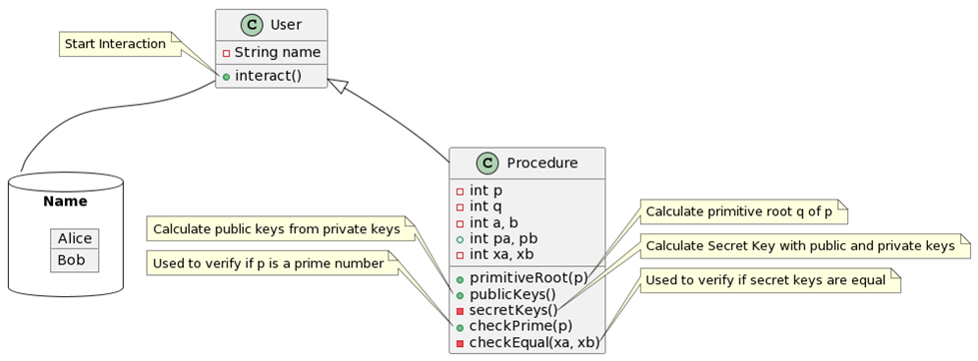
Classes and Functions - User
In this algorithm we have 10 variables; prime number(p), primitive root(q), private key(a and b), public key(pa and pb) and secret keys(xa and xb).

Slide 5

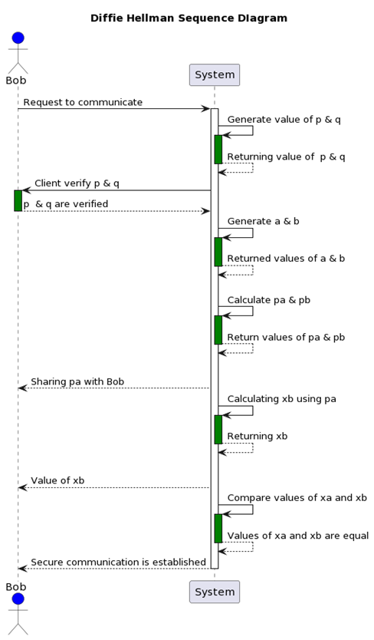

Algorithm
Here 'p' and 'q' are available to both clients trying to interact. 'q' is calculated from 'p'. Later, both clients decide their own private key 'a' and 'b'. They use this private key to create public key 'pa' and 'pb' which is public to both clients. Both clients exchange their public keys and use it to create secret key 'xa' and 'xb'. If these secret keys are similar then a secure connection is established among them

Slide 6
Methodology
Procedure
USER
primitiveRoot()
checkPrime()
interact()
findPrimeFactors()
powerexp()
power()
publicKeys
secretKeys

Slide 7


Thank you for your time!

